Slide 1
Impact of Coal-to-Natural Gas Conversion of Power Plants on Property Values​
Erdal Asker, Heather Bono, Hilde Patron, & Joey Smith
University of West Georgia
ACADEMY OF ECONOMICS AND FINANCE ANNUAL MEETING 2025
PENSACOLA BEACH, FL

Slide 2
Introduction
Power plants are increasingly transitioning from coal to natural gas due to environmental, economic, and regulatory pressures.
Natural gas burns cleaner, emitting fewer greenhouse gases and pollutants, which helps mitigate climate change and improve air quality.
It is also more cost-effective and efficient, offering better flexibility for meeting electricity demand.
As stricter environmental regulations are enforced and domestic natural gas supplies grow, this shift is becoming a more sustainable and secure energy option for power generation.
We investigate how shifting from coal to natural gas influences regional economies, focusing on its effects on local housing markets.

Slide 3

Plant Yates
Plant Yates began commercial operation in 1950 in Coweta County, Georgia, and five of the seven coal-fired units were retired in 2015. The two remaining units, capable of producing 700 MW of electricity, were converted to natural gas.

Slide 4
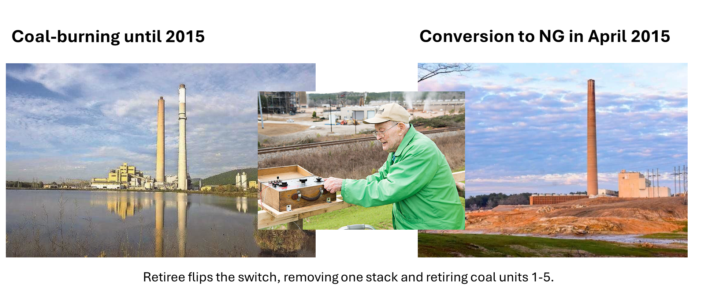
The Conversion to Natural Gas

Slide 5
Literature
Davis (2011)
Apartments located within 2 miles of power plants have 3%-7% lower prices than comparable houses
Mei, Gao, Zhang, and Yang (2021)
Coal-to-gas conversion leads to a positive price premium of 11% for nearby properties
Fraenkel, Zivin, and Krumholz (2024)
Coal-to-gas conversion results in housing value increases by approximately 3% for those close to the plant, whereas those farther away appreciate at as statistically insignificant 0.3%.
Rivera and Loveridge (2022)
The shutdown of coal-fired generators increased property values by roughly 12%–20% within 1 mile of distance from fuel-switching stations.
Farah, Boslett, and Hill (2019)
Coal-fired power plant closure increases the prices of downwind properties within 2 miles by about 9%-26% and that a 1% year-over-year coal use decrease in a dual-fired plant raises the prices of downwind properties within 10 miles by 0.15%-1.3%.

Slide 6
Data
Qpublic and the Carroll and Coweta County Tax Assessors Data
Census Tract Data
Years 2010-2020
Includes
Address
Year built
Sale Date
Sale Price
Acres
Square footage
Distance to Atlanta and nearest major city calculated using Maptitude GIS

Slide 7
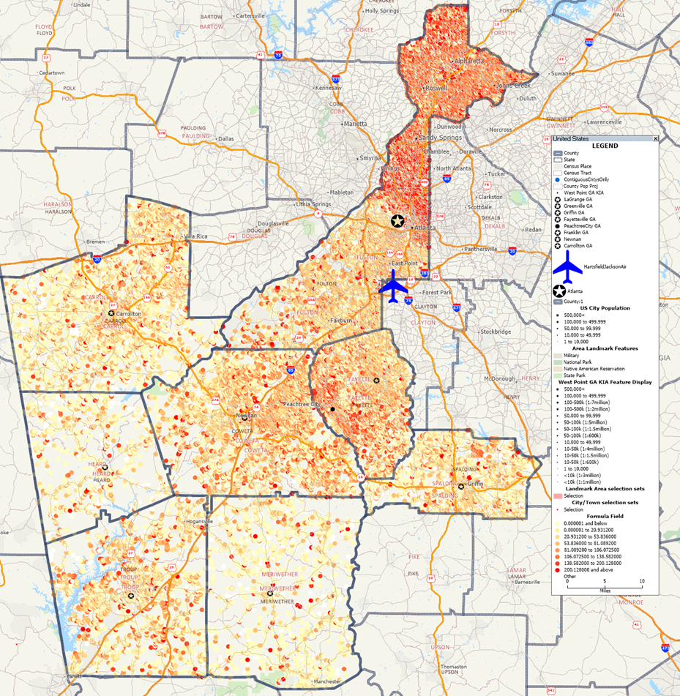

Sales - $ per Square Foot for Sales (10 years)

Slide 8
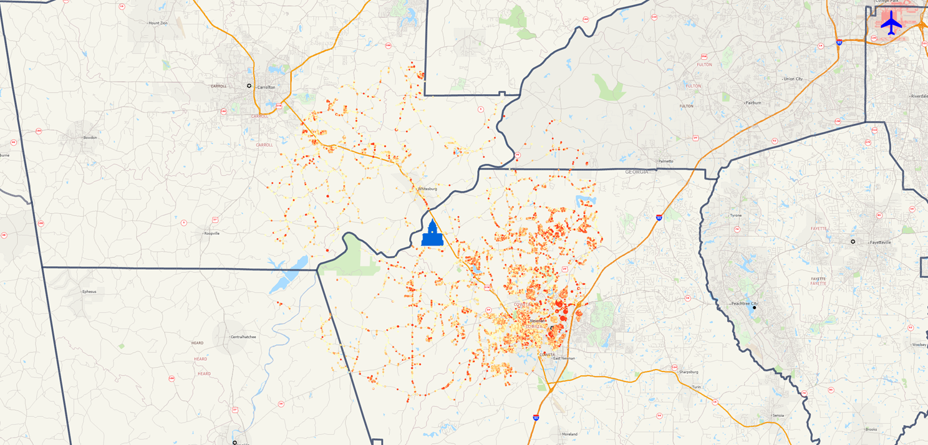
Sales - Properties within 10-mile Radius of Yates (34,459 sales during the period)

Slide 9
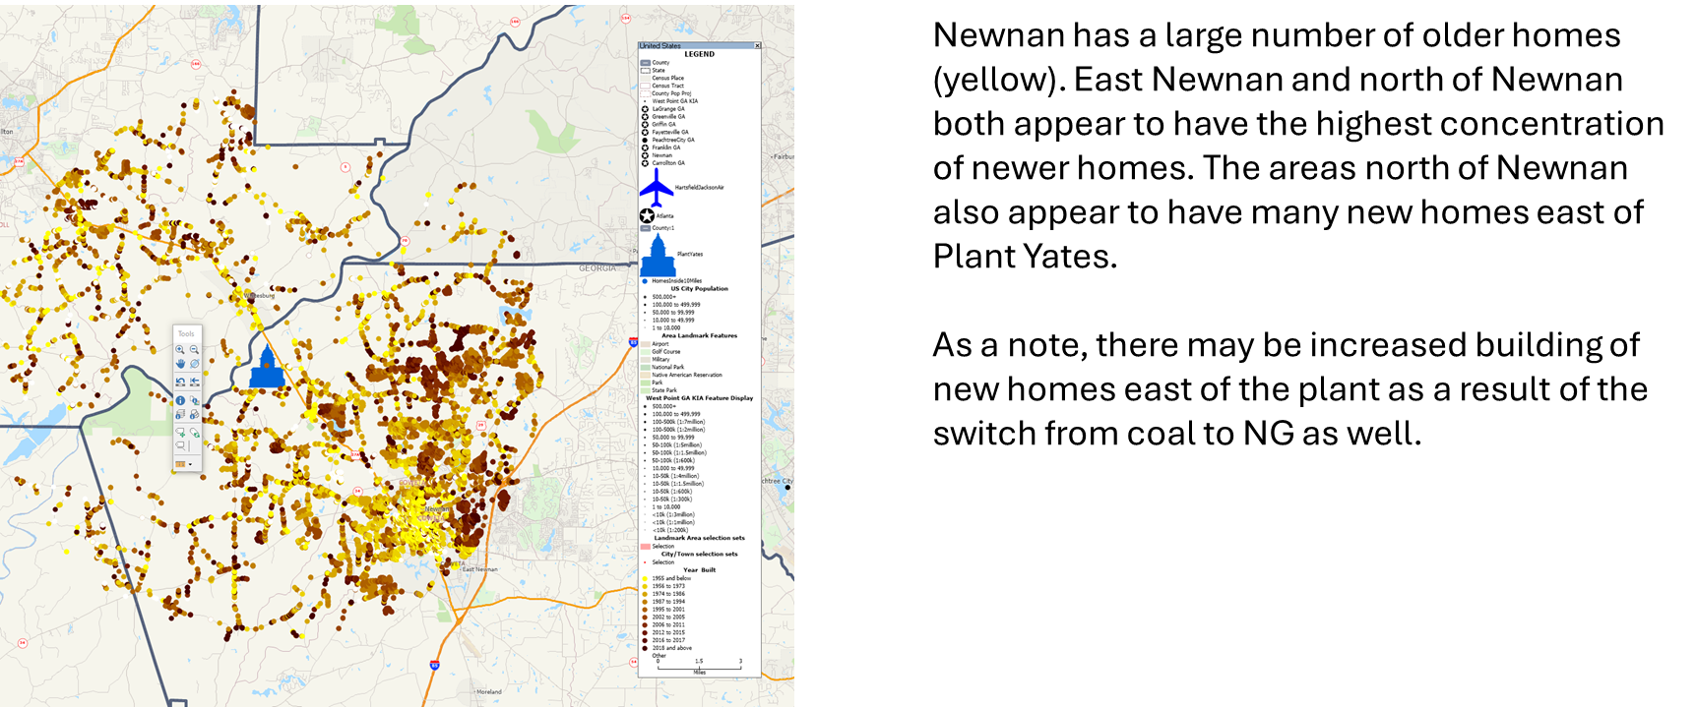
Year Built

Slide 10
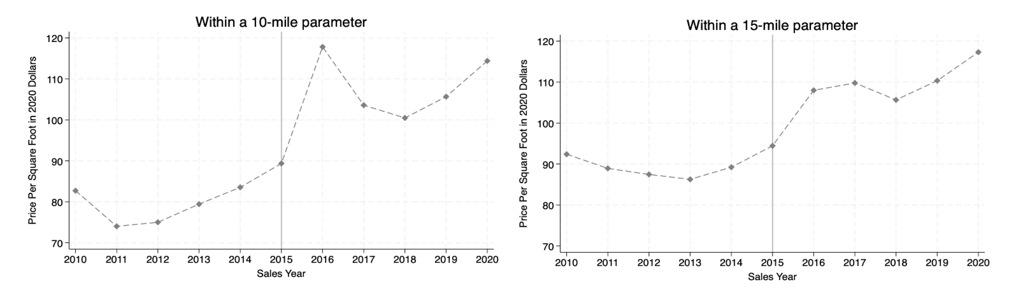
Price Per Square Foot in 2020 dollars

Slide 11
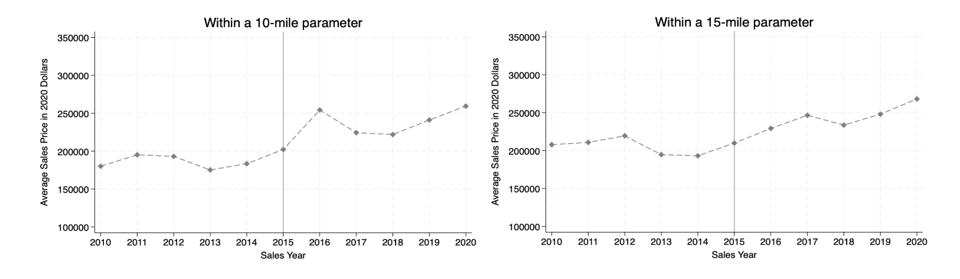
Average Sales Price in 2020 dollars

Slide 12
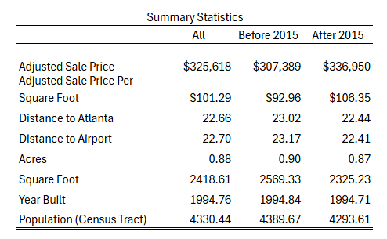
Summary Statistics

Slide 13
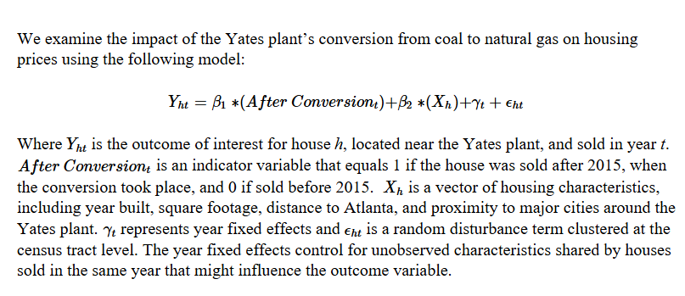
Methodology

Slide 14
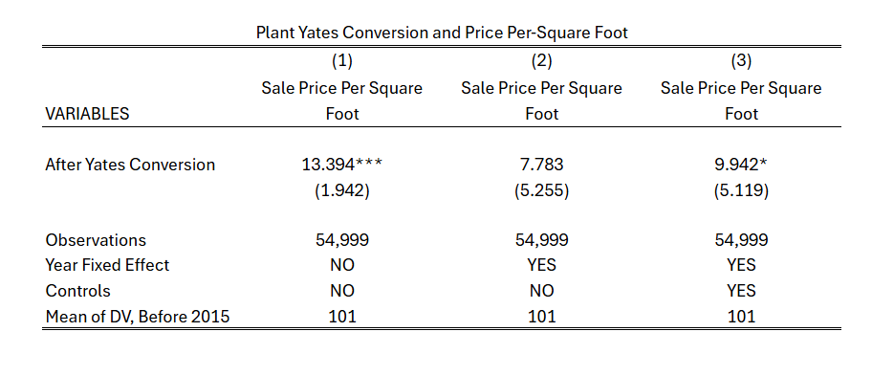
Results: Price per square foot- all

Slide 15
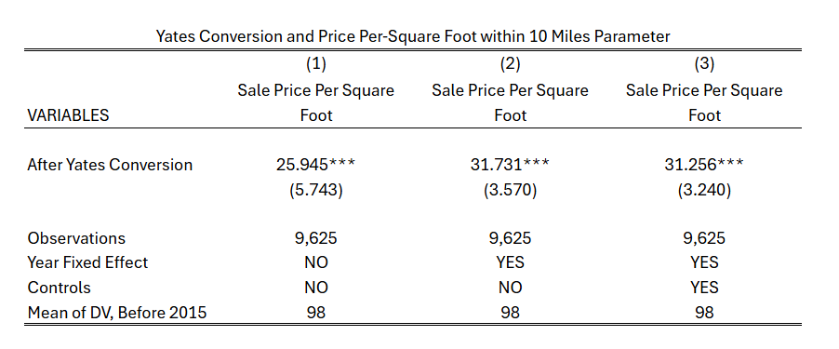
Results: Price per square foot- within 10-mile parameter

Slide 16
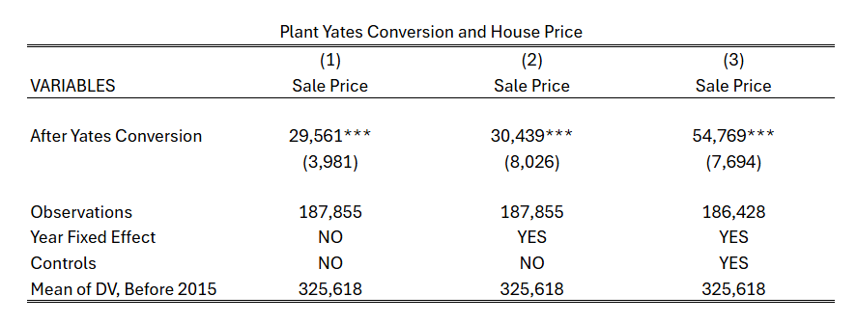
Results: House Price - all

Slide 17
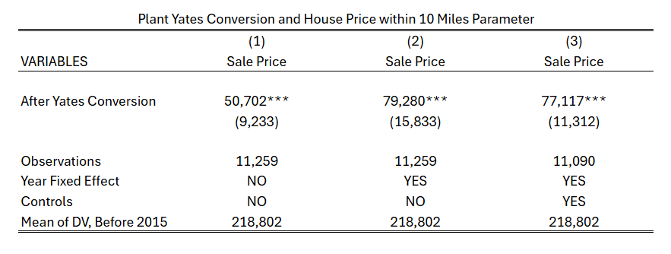
Results: House Price – within 10-mile parameter

Slide 18
Next Steps...
Conduct a difference-in-difference approach that use records of residential property transactions of homes with pollution exposure and proximity to the fuel-switching plant before and after the switch along with the use of homes near a coal-fired plant that has not made this conversion.
Evaluate the impact of switching from coal to natural gas on:
land values
building permits
type of construction
demographic composition

Slide 19
Questions??
Thank you!

